Slide 1
Wi-Fi:
Starspace 46 guest
Password:
Techlahoma

Slide 2
OKC Python
meetup.com/okcpython
twitter.com/okcpython

Slide 3
Thanks for joining us today!
We're here thanks to volunteers, speakers, and Techlahoma.

Slide 4
What is Techlahoma?
non-profit volunteer-run organization
hosts 33 groups and 2 conferences
sponsors free local events
supports the grassroots tech community of Oklahoma

Slide 5
Techlahoma.org
meetup.com/pro/Techlahoma
twitter.com/Techlahoma
donate.techlahoma.org/membership

Slide 6
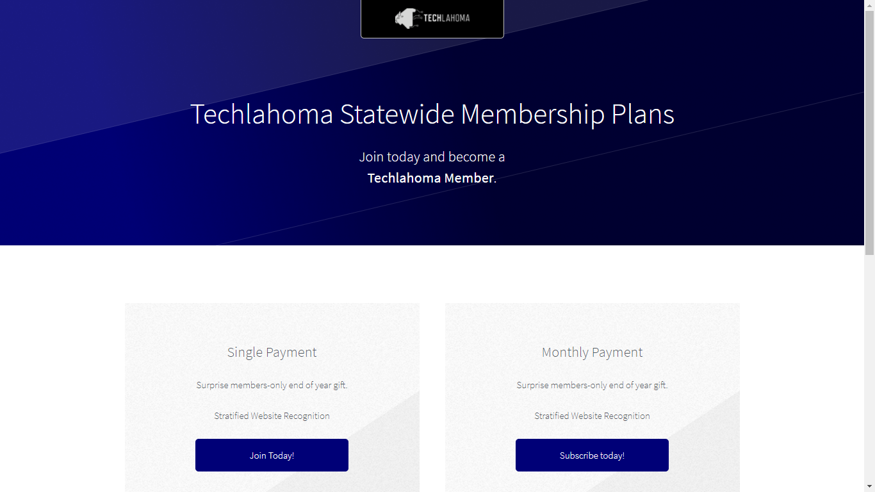

Slide 7
StarSpace46.com
starspace46.com/calendar-1
twitter.com/StarSpace46
Community membership $40/month

Slide 8
Twitch.tv/Techlahoma
Live streaming at StarSpace46
Subscribe with Amazon Prime
Techlahoma gets a small donation from Amazon

Slide 9
Slack
techlahoma.org/spaces
#pythonista channel

Slide 10
OKC Ruby
Thursday 1/11
11:30 - 12:30
The Odin Project: Advantages and Drawbacks of the Meta-Tutorial
meetup.com/okc-ruby

Slide 11
OKC Open Source Hardware
Saturday 1/13
2:00 - 4:00 pm
Meet Liger! A FOSS light switch
for home automation/security
meetup.com/okc-osh

Slide 12
Free Code Camp OKC
Sunday 1/14
2:00 - 3:00 pm
Intro to APIs
meetup.com/freecodecampokc

Slide 13
OKC Python February Meetup
Wednesday 2/14
11:30 - 12:30
Using Python for Analytics (Jess Hale)
meetup.com/okcpython

Slide 14
OKC Python March Meetup
Wednesday 3/14
11:30 - 12:30
Speaker: You?
meetup.com/okcpython

Slide 15
Topic Suggestions:
github.com/okcpython/presentations

